Slide 1
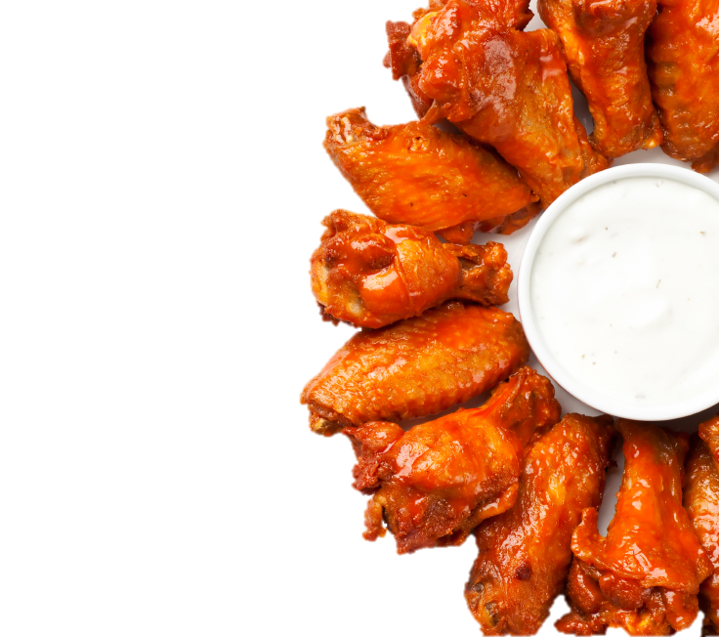
COMBO MEALS
Comes with a side and a drink (❺ & ❼ - drink only)
❶
10 piece Wings or Boneless Bites
............
7.99
❷
……......
6.99
Philly Sandwich - Beef / Chicken
❸
6 piece Wings or Boneless Bites
............
6.49
❹
Philly Sandwich & 6 pc Wings or Boneless Bites
...........
8.99
❾
Deluxe Sandwich Smoked Pulled Pork / Chicken / Beef
6.49
..
❺
Shrimp Fried Rice & 6 pc Wings or Boneless Bites plus a drink
.......
8.49
❿
………......
5.99
Wraps - Fish / Chicken
❻
2 piece Fish (fried or grilled)
…..……...
6.99
⓫
………....
6.99
2 Tacos - Fish / Chicken
❼
Shrimp Fried Rice & 10 pc Wings or Boneless Bites plus a drink
9.99
…...
⓬
11.49
16 piece Wings or Bnlss Bites
...
❽
1 piece Fish & 6 piece Wings or Boneless Bites
..…......
8.99
Substitute a side to a fried rice (Shrimp / Chicken / Beef) with $1.59. Vegetable - $0.50
❶❷❸❹❺❻❼❽❾❿⓫⓬❶❷❸❹❺❻❼❽❾❿⓫⓬

Slide 2

WINGS
WING FLAVORS
Wings Only
w/ F fries
Hot Extra Hot Honey Hot
Mild Medium Extra Mild
Lemon Pepper Garlic Pepper Honey Garlic Pepper
Ranch Cajun Honey Mustard
Teriyaki Hot Teriyaki BBQ Plain
6 pc
4.99
5.99
10 pc
6.99
7.99
20 pc
12.59
13.59
30 pc
18.99
19.99
FISH
50 pc
29.99
Fish Only
w/ F fries
100 pc
54.99
2 pc
5.49
6.99
3 pc
6.99
8.49
DELUXE SANDWICH
4 pc
9.99
10.99
Sand. Only
w/ F fries
6 pc
13.99
14.99
5.49
6.99
Philly Chicken / Beef
Chicken
Tilapia & Catfish - can be grilled, blackened, cajun, or lemon pepper.
Whiting – Fried Only.
Comes with one side order, cole slaw, and tartar sauce.
4.49
5.99
Pulled Pork
5.99
4.49
Burger
5.99
4.49

Slide 3
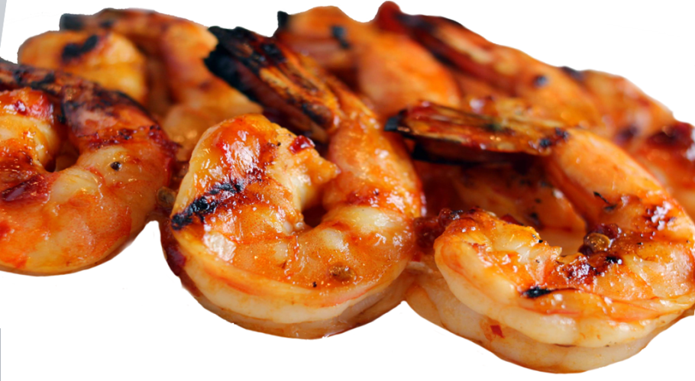
GRILLED SHRIMP
CHICKEN TENDERS
SALAD
Shrimp Only
w/ F fries
Tender Only
w/ F fries
2 Pcs
3.49
4.99
Chicken Salad
Grilled / Fried Chicken
5.99
6 Pcs
5.99
7.49
8 Pcs
7.99
9.49
4 Pcs
5.49
6.99
Fish Salad
Grilled / Fried Fish
5.99
12 Pcs
11.99
13.49
6 Pcs
7.49
8.99
8 Pcs
9.49
10.99
DRINKS
BUTTERFLY SHRIMP
Shrimp Only
w/ F fries
SIDE ORDERS
Medium Drink
1.99
6 Pcs
4.49
5.99
Small
Large
Large Drink
2.49
8 Pcs
5.49
6.99
French Fries
1.99
2.99
12 Pcs
7.99
8.99
Egg Roll
1.99
2.99
Coleslaw
1.99
2.99
FRIED RICE
Onion Rings
2.49
3.99
Small
Large
Vegetable
2.99
4.49
Hushpuppies
2.49
3.99
Beef / Chicken
3.99
5.99
Fried Okra
2.49
3.99
Shrimp / House
4.49
6.49
Garden Salad
2.49
3.99

Slide 4



Wings Only
w/ Side
Hot Extra Hot Honey Hot
Mild Medium Extra Mild
Lemon Pepper Garlic Pepper Honey Garlic Pepper
Ranch Cajun Honey Mustard
Teriyaki Hot Teriyaki
BBQ Plain
6 Pcs
$4.49
$5.49
10 Pcs
$6.99
$7.99
20 Pcs
$13.99
$15.99
30 Pcs
$19.99
$22.99
50 Pcs
$31.99
$33.99
75 Pcs
$43.99
$45.99
100 Pcs
$59.99
$63.99
Fish Only
w/ Side
2 Pcs
$5.49
$6.99
3 Pcs
$6.99
$8.49
Philly Sandwich
$5.49
4 Pcs
$9.99
$10.99
Philly w/ Side
$6.99
6 Pcs
$13.99
$14.99
Philly w/ 6 Pc Wings
$8.49
Tilapia & Catfish - can be grilled, black cajun, or lemon pepper.
Whiting – Fried Only.
Comes with one side order, coleslaw, and tarter sauce.
Grilled extra lean Steak or Chicken & Onion, Bell pepper, Mushroom, Mayo with Melted White Cheese

Slide 5




